Slide 1
Free Will

Slide 2
What is Free Will?
I could have done other than I actually did.
There may be good reasons for our actions, but they’re not undeniable
Free Will is required for Moral Judgements

Slide 3

Determinism
What happens at time t is completely determined by the state of the world at time t-1

Slide 4
Determinism vs Free Will
Human beings should also be deterministic
P1. Our choices are the product of deterministic laws and initial conditions.
P2. If our choices are the product of deterministic laws and initial conditions then we don’t have Free Will.
-------------------------------------------------------
C. We don’t have Free Will.

Slide 5
Determinism vs Free Will
Position | P1 Choices are Determined | P2 If Choices are Determined then no Free Will | C No Free Will
Hard Determinism
Soft Determinism
Compatibilism
Liberalism
ü
ü
ü
ü
r
r
r

Slide 6
Determinism vs Free Will
Libertarianism
  If Free Will and Determinism are incompatible then reject Determinism
  Are we really free if we are acting at random?
  Certainly can’t blame a random actor for his acts

Slide 7
Determinism vs Free Will
Compatibilism
  Free Will and Determinism could both be true, i.e.
  P2 is false
  Take no position on P1

Slide 8
Determinism vs Free Will
Compatibilism
  Why think P2 is true?
P3 If we have FW then X
P4 If determinism is true then not X
-----------------------------------------------------
C2 If we have FW then determinism is not true, and if determinism is true then we don’t have FW

Slide 9
Determinism vs Free Will
Compatibilism
  Why think P2 is true?
P3₁ If we have FW then we can do other than we do
P4₁ If determinism is true then we can not do other than we do
-----------------------------------------------------
C2₁ If determinism is true then we don’t have FW.

Slide 10
Determinism vs Free Will
Compatibilism
  Why think P2 is true?
P3₂ If we have FW then if we choose otherwise we will do otherwise
P4₂ If determinism is true then if we choose otherwise we will not do otherwise -----------------------------------------------------
C2₂ If determinism is true then we don’t have FW.

Slide 11
Determinism vs Free Will
Compatibilism
  Why think P2 is true?
P3₂ If we have FW then if we choose otherwise we will do otherwise TRUE
P4₂ If determinism is true then if we choose otherwise we will not do otherwise FALSE -----------------------------------------------------
C2₂ If determinism is true then we don’t have FW.

Slide 12

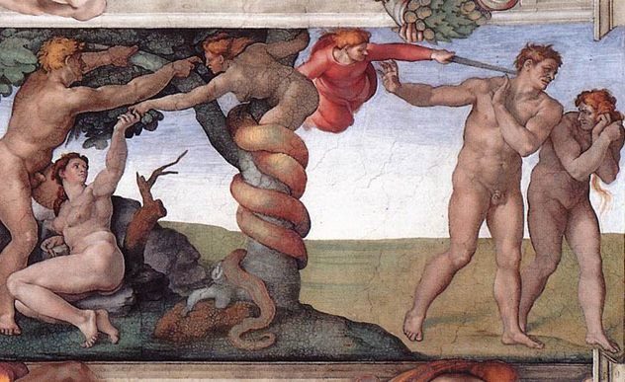
Other Objections to Free Will
Statements about the future are true or false
There will be a sea-battle tomorrow
Predictability
  God knows our future – we have no FW
  Even we can predict what other people will do

